Slide 1
Predicting Obesity
© Templateswise.com
Machine Learning Project by Dustin White

Slide 2
Key Questions for Presentation
4. What results and conclusions have you drawn?
5. What were the variables of greatest impact?
6. What decisions or actions does your model enable you to carry out? What are the business implications?

Slide 3
What problem am I going to solve?
The problem I aim to solve is to accurately predict whether individuals are obese based on a range of categorical variables.
Obesity is a significant public health concern linked to numerous diseases such as diabetes. Early detection can help to prevent these diseases and improve public health.
By identifying patterns and relationships within this data, ML models can predict obesity in individuals.

Slide 4
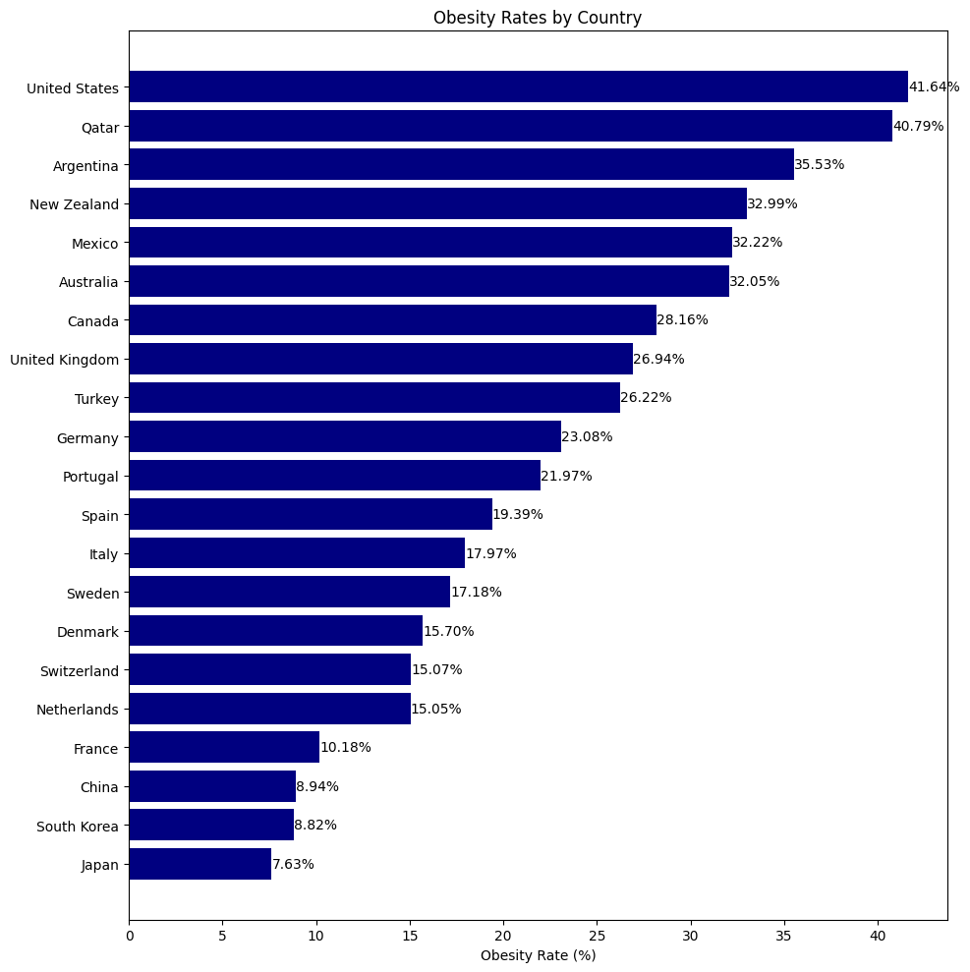

Slide 5
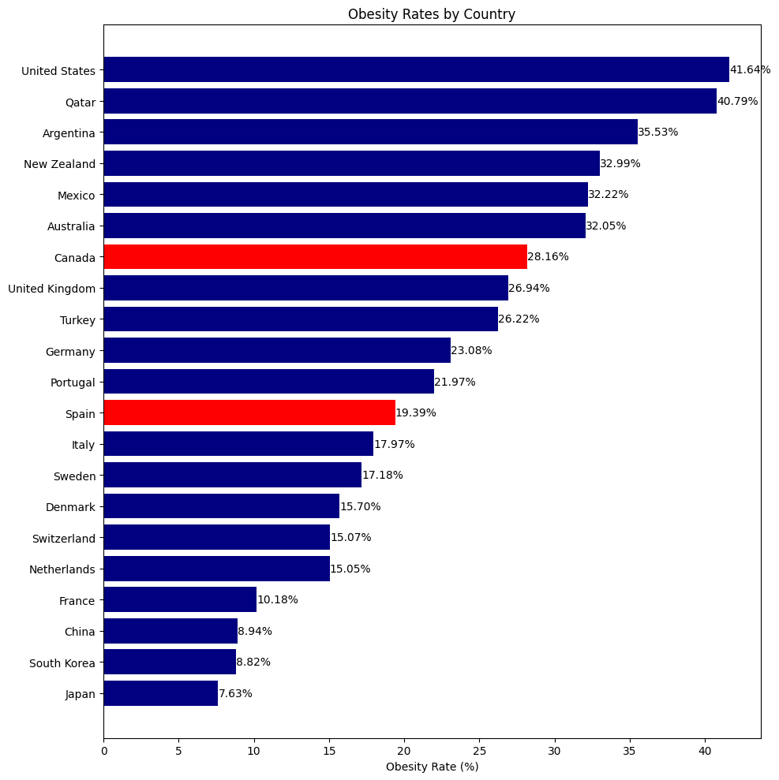

Slide 6
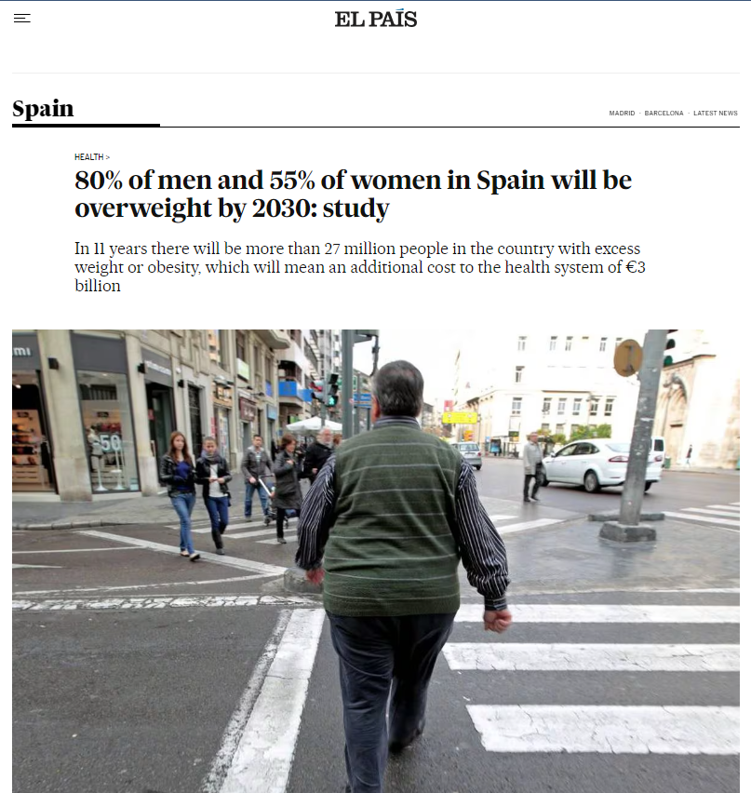

Slide 7

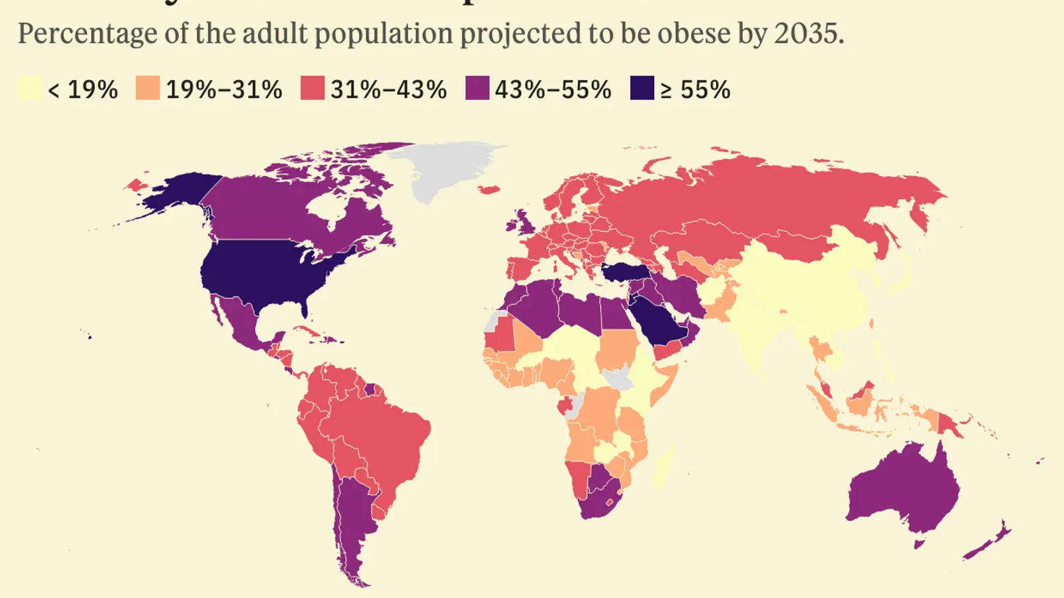

Slide 8
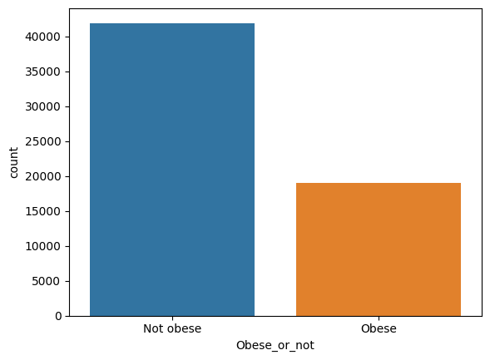
dataset
Categorical variables with records of (60920, 16)
Unbalanced:
Not obese: 41906
Obesese: 19014

Slide 9

Categorical Variables
Province
Sex
Marital status
Age
Working (past 12 months)
Education level
Perceived life stress
Smoker
Drinker (past 12 months)
Physical activity
Has a regular healthcare provider
Immigrant
Cultural or racial background
Food security
Personal income

Slide 10
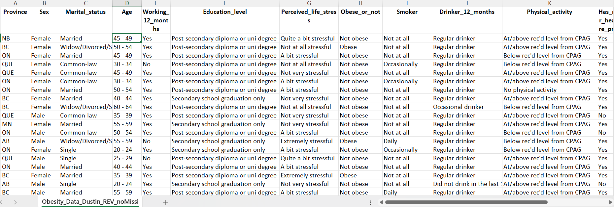

Slide 11
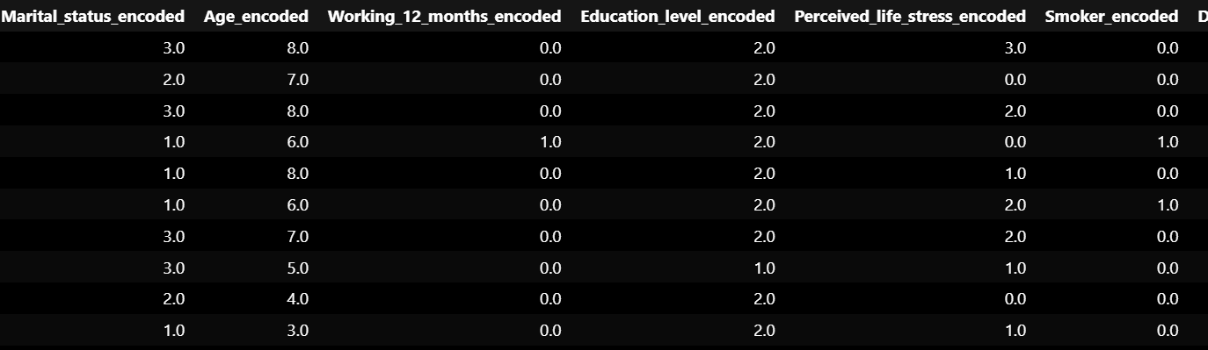

Slide 12
Machine Learning Models Used
Logistic Regression
Decision Trees
Random Forest
XGBoost
SVM

Slide 13
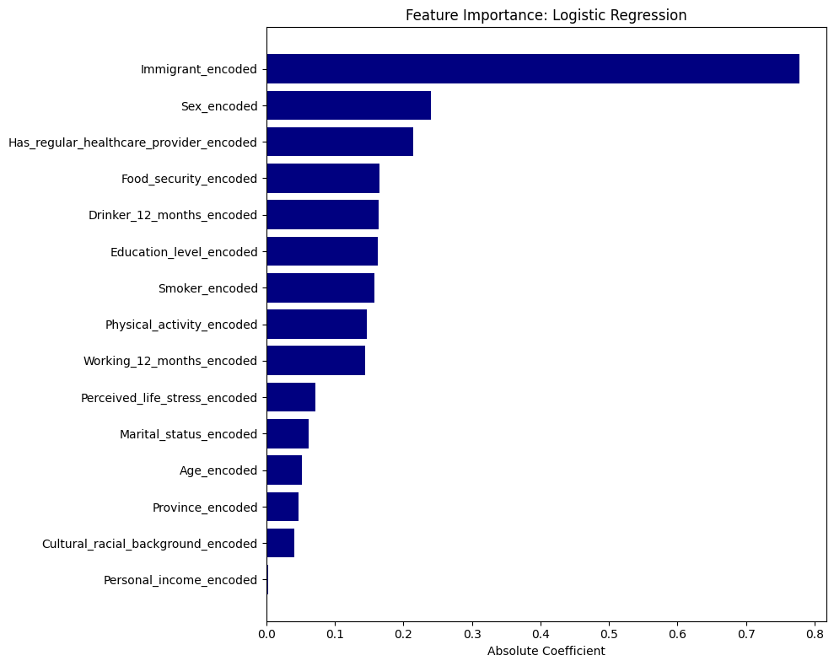

Slide 14
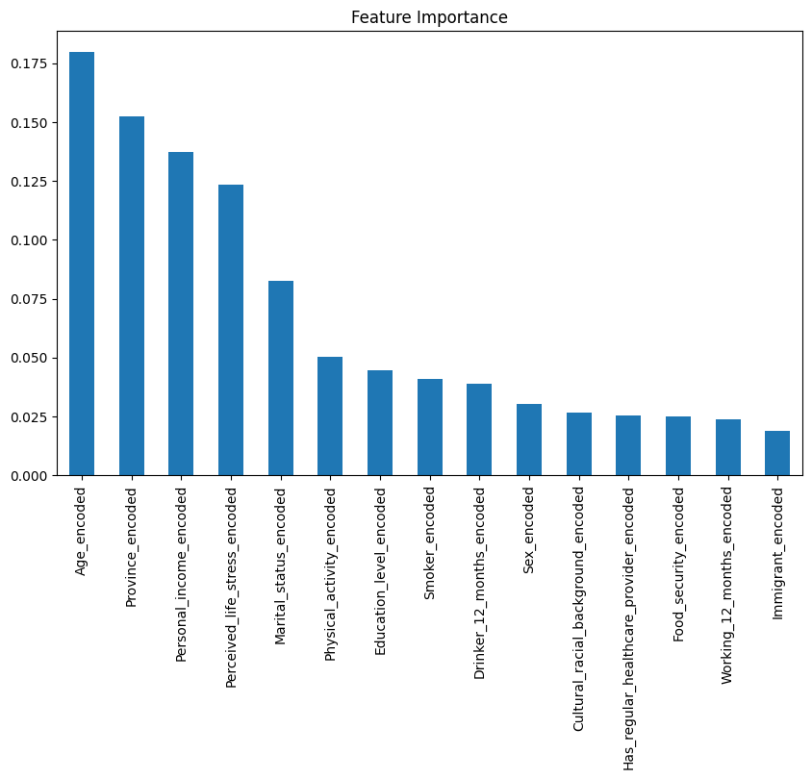
Feature Importance: random forest

Slide 15
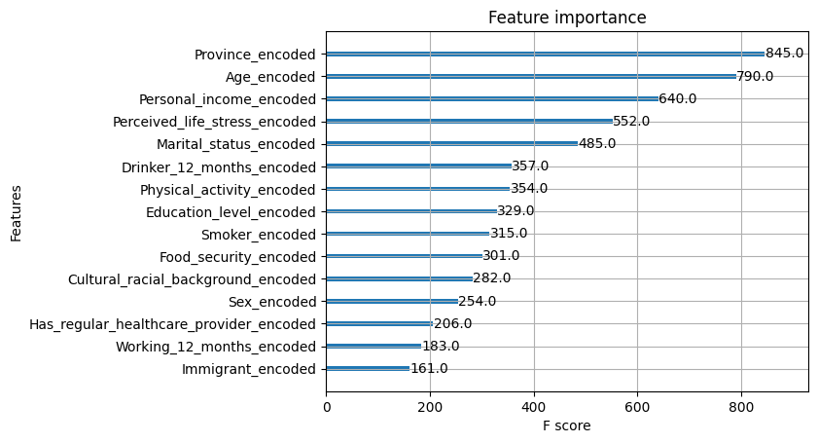
Feature importance: xgboost

Slide 16
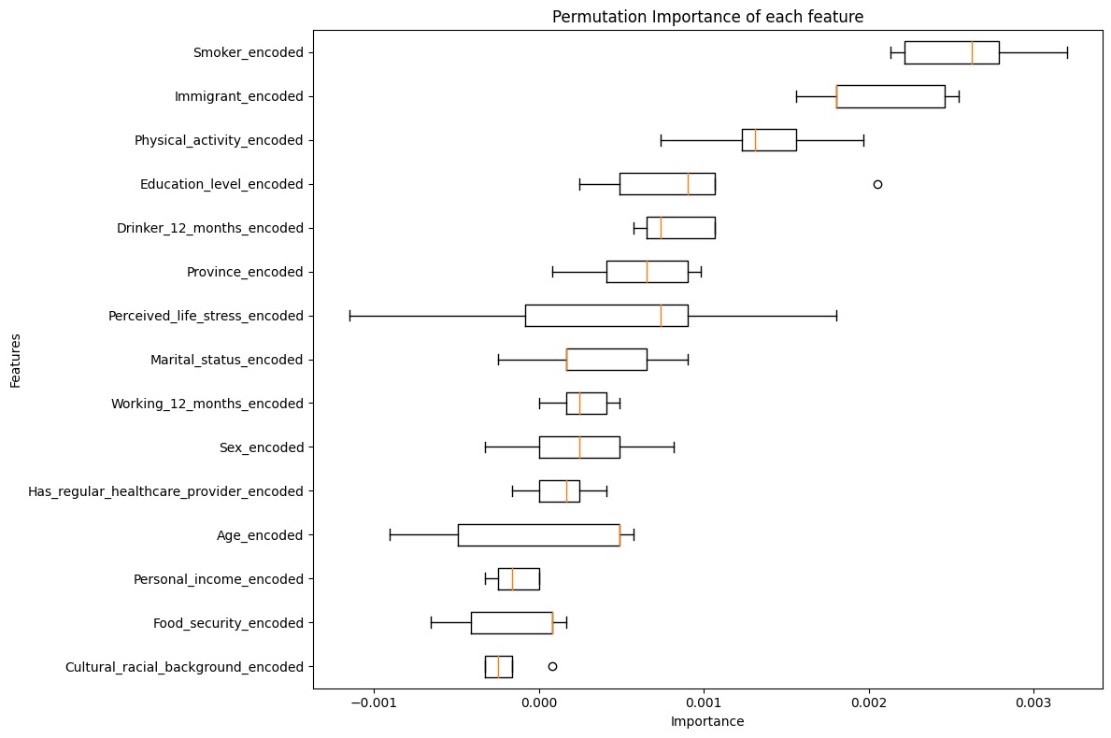

Slide 17
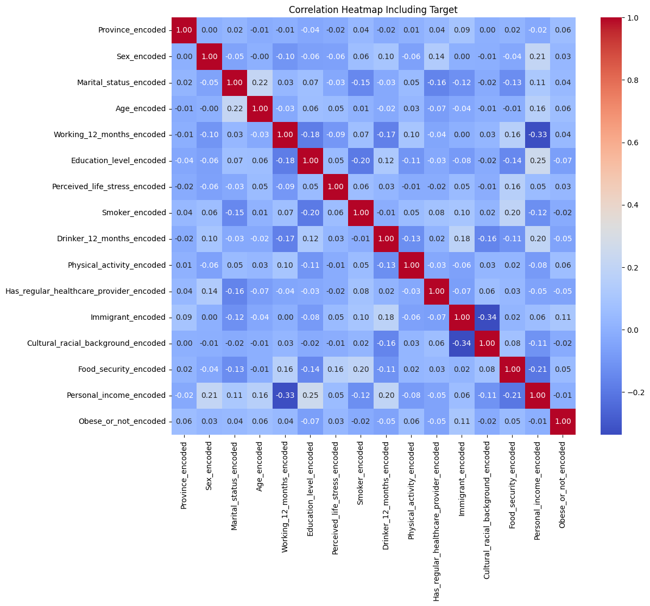

Slide 18
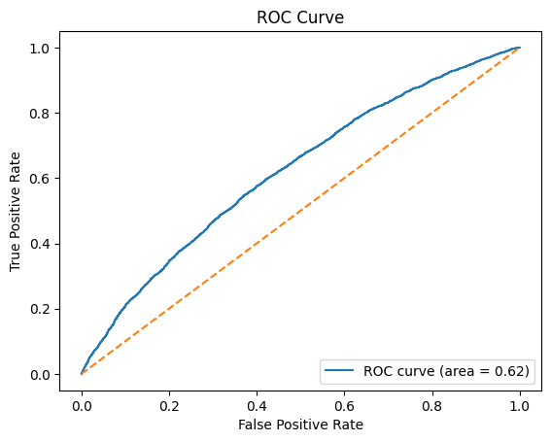
Logistic regression: 1st attempt default
Accuracy: 58%
F1 score: 8%

Slide 19
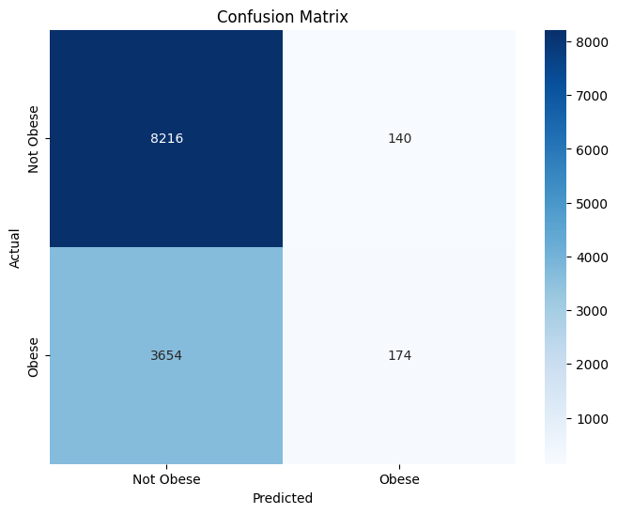
Logistic regression: 1st attempt default

Slide 20
Logistic regression: final attempt ‘weighted’
Accuracy: 61%
F1 score: 45%

Slide 21
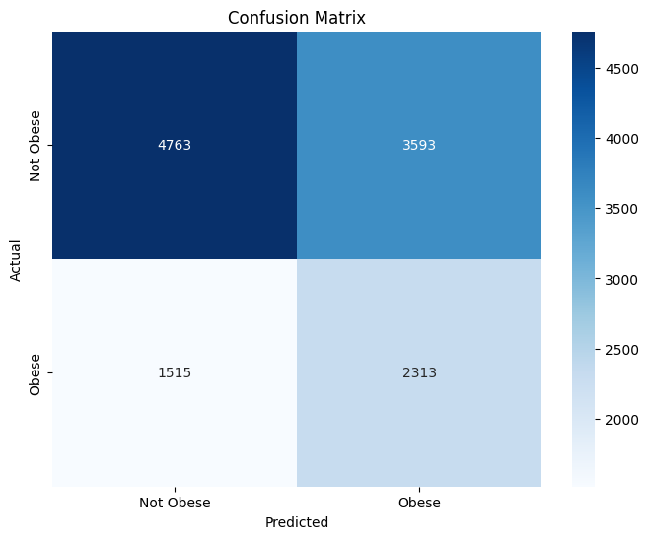
Logistic regression: First attempt ‘balanced: - true positives increased drastically but so did false positives. False negatives decreased but so did true negatives

Slide 22
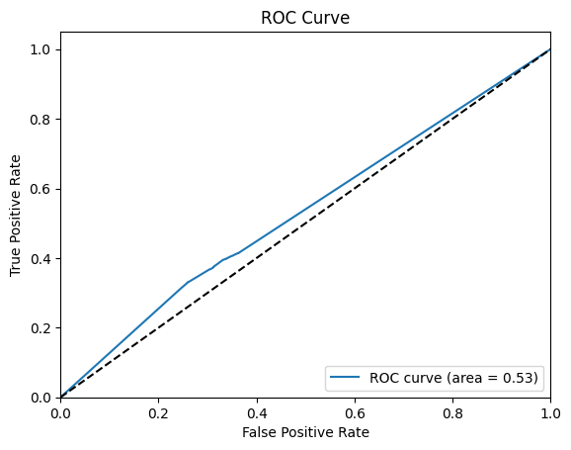
Decision trees model: 1st attempt
Accuracy: 58%
F1 score: 36%

Slide 23
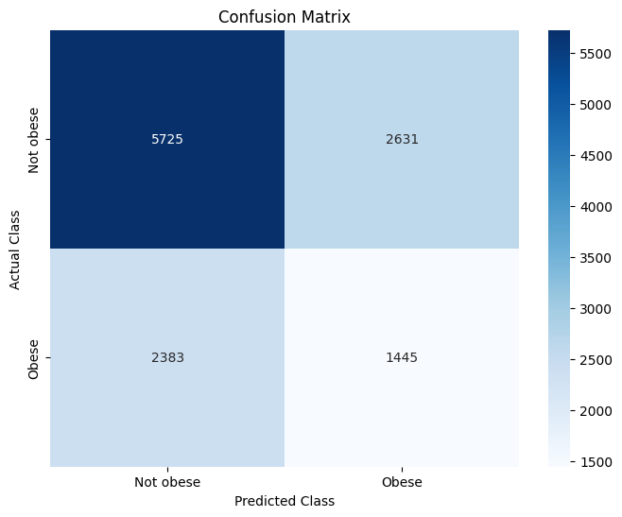
Decision trees model: 1st attempt

Slide 24
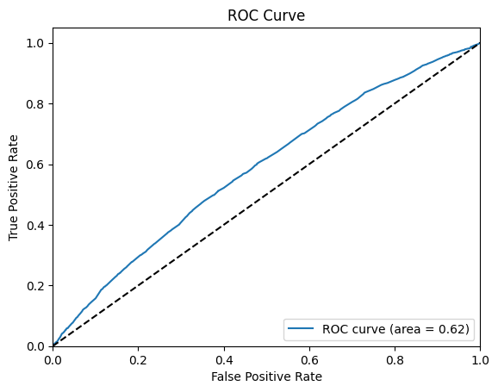
Decision trees model: parameter grid
Accuracy: 68%
F1 score: 19%

Slide 25
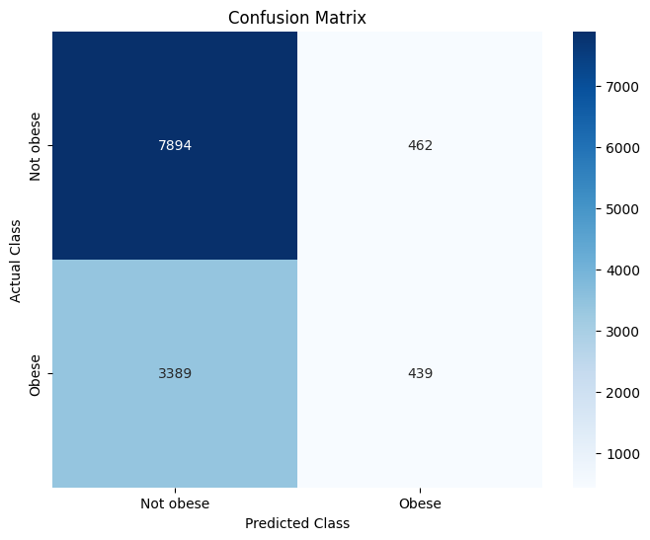
Decision tree: parameter grid

Slide 26
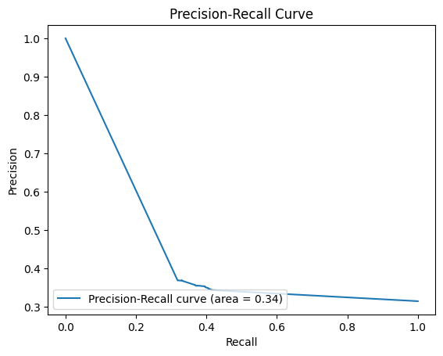
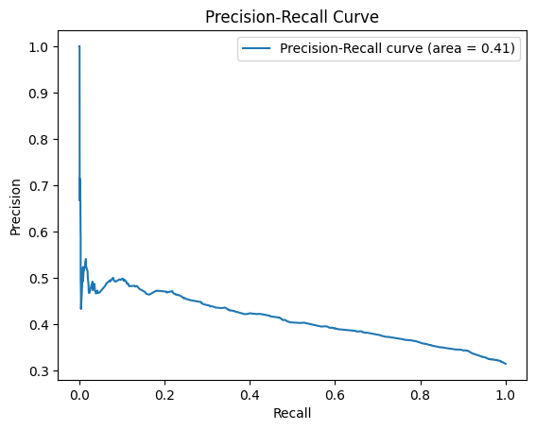
Decision Tree 1st Attempt vs Parameter Grid

Slide 27
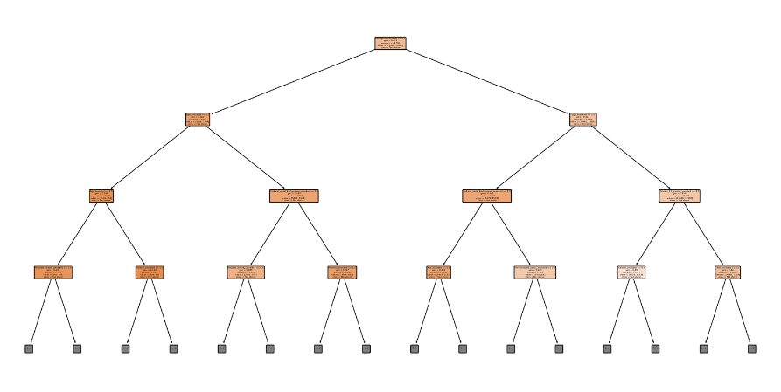
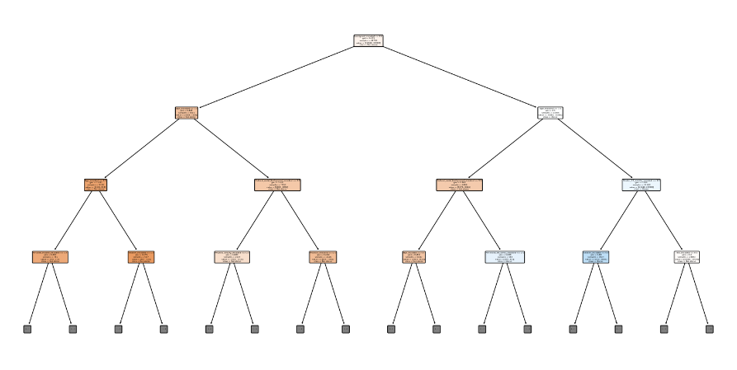

Slide 28
Decision trees: recursive elimination
All metrics got worse
Accuracy and F1 decreased along with the ROC-AUC score.

Slide 29
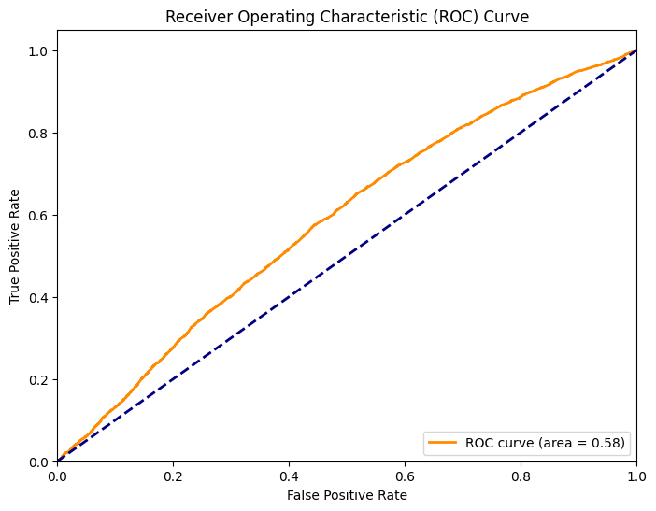
Random forest model: 1st attempt
Accuracy: 64%
F1 score: 29%

Slide 30
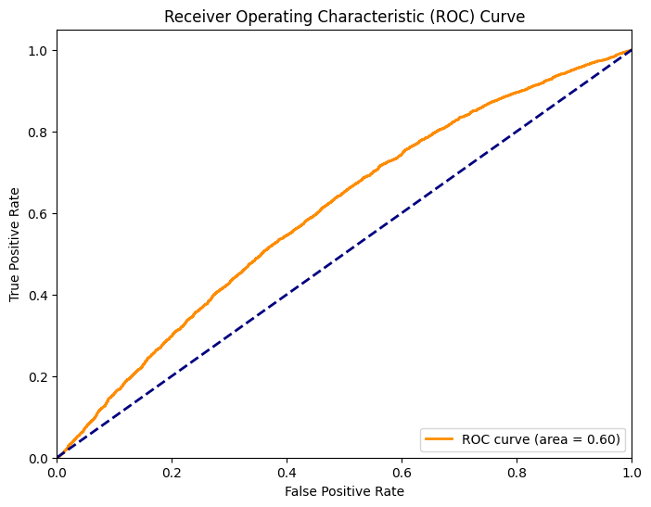
Random forest model: SMOTE TO BALANCE CLASSES
Accuracy: 63%
F1 score (weighted average): 62%

Slide 31
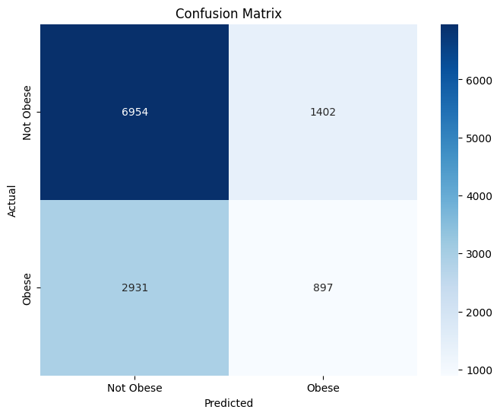
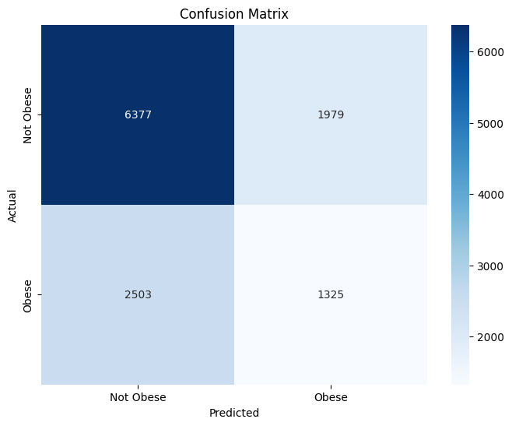
Random forest: 1st attempt compared to smote

Slide 32
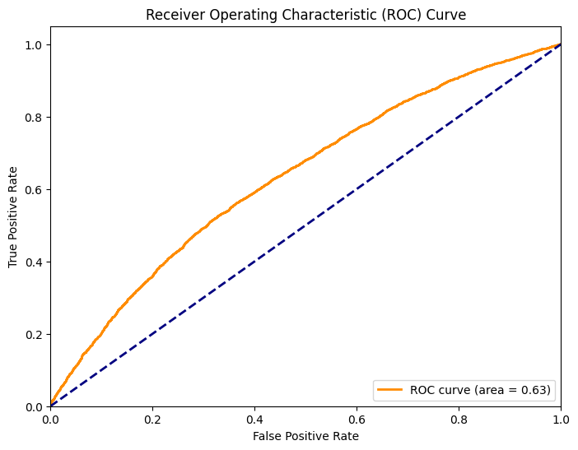
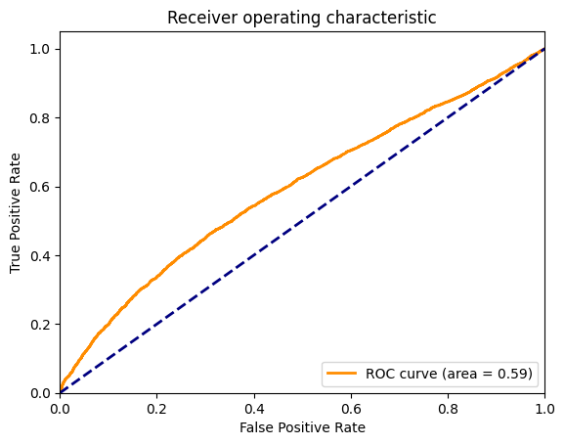
XGBOOST: 1st attempt vs hyperparameter tuning

Slide 33
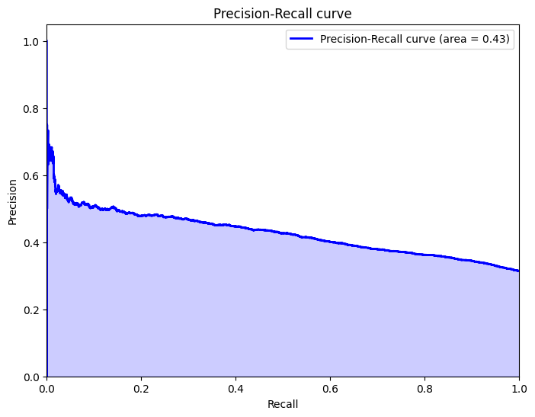
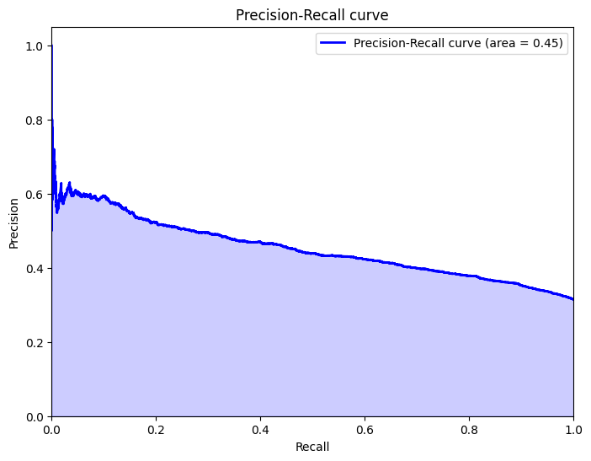
XGBOOST: 1st attempt vs hyperparameter tuning

Slide 34
XGBOOST: 1st attempt vs hyperparameter tuning
Metrics got only slightly better
Accuracy: 60%
F1: 62%
Accuracy: 65%
F1: 62%

Slide 35
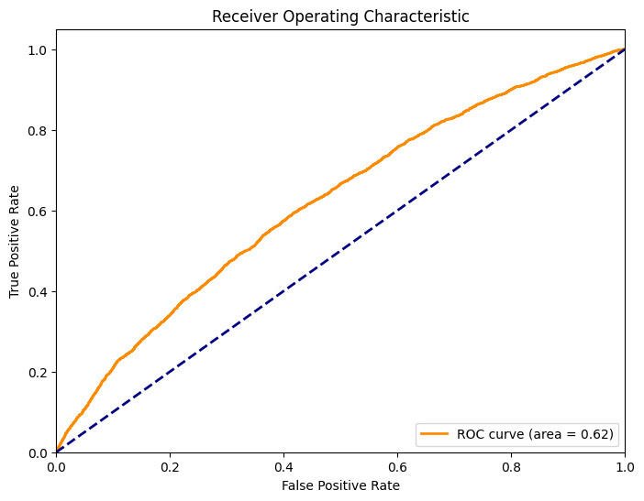
SVM: linear model vs RBF Kernel with RandomizedSearchCV
Accuracy: 68%
Accuracy: 69%

Slide 36
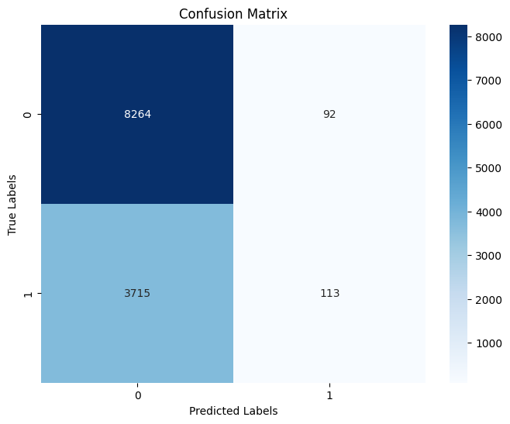
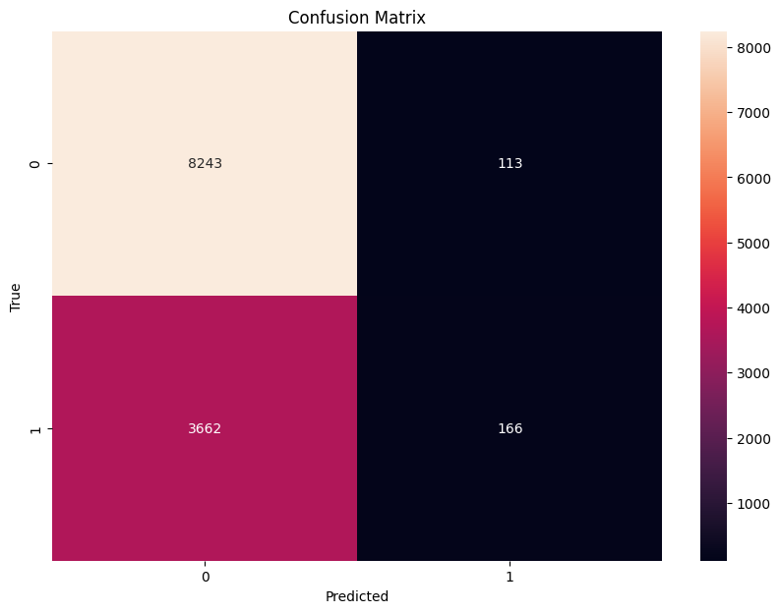
SVM: linear model vs RBF Kernel with RandomizedSearchCV

Slide 37
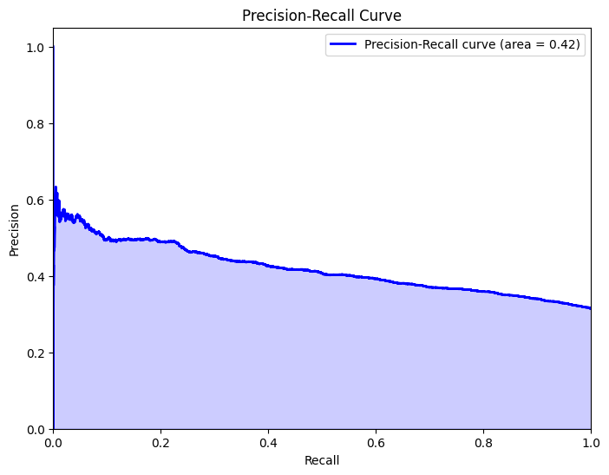
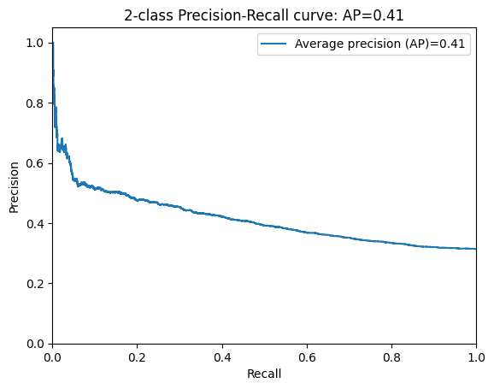
SVM: linear model vs RBF Kernel with RandomizedSearchCV

Slide 38
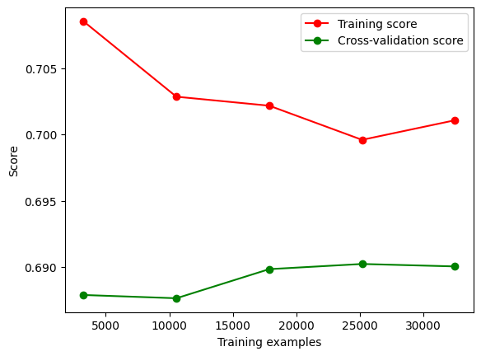

Slide 39
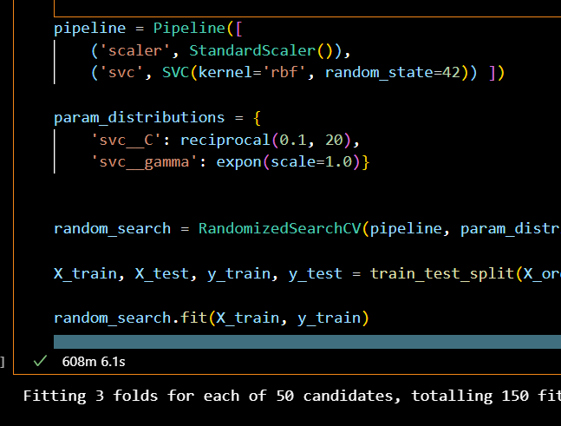
Took awhile…

Slide 40
Which model worked best in the end?
Best Accuracy: SVM: RBF Kernel with RandomizedSearchCV
Best F1 score: XGBOOST with Hyperparemeter tuning
Best ROC-AUC: XGBoost 1st attempt
Best Precision-Recall: XGBoost 1st attempt

Slide 41
Recall is arguably the best metric in this case
Why?
Recall is the best because the cost of false positives is low.
If someone is overweight and is falsely classified as ‘obese’, the worst thing to happen is that their doctor would tell them to take their weight more seriously.
This differs from other health-related models where the the cost of a false positive could potentially lead to unnecessary, treatments like medication or surgery.

